Slide 1
Needs assessment exercise overview and case studies
Shorn Molokwane
Botswana Institute for
Technology Research and Innovation

Slide 2
BITRI at a glance
Established in 2012
Is a company limited by guarantee governed by a Board of Directors
Reports to the Minister of Tertiary Education, Research, Science and Technology
BITRI is situated at Maranyane House in Gaborone
Has other campuses in Gaborone, Kanye and Palapye.

Slide 3
Mandate
To conduct needs based technology research and development in focused areas of national interest
To deliver affordable, effective high quality technology solutions that maximise the beneficiation of local resources, through both institutional and collaborative programmes
To effectively address current and anticipated needs for sustainable socio-economic development;

Slide 4
BITRI Vision & Mission
Mission
To conduct needs-based technology research that provides sustainable innovative solutions through co-creation and collaboration
Vision
To be the leading technology solutions provider that transforms lives

Slide 5

BITRI Philosophy
At BITRI co-creation and collaboration is at the centre of what we do as espoused by our philosophy

Slide 7
Research Priority Areas
Technologies
Electronics and Communications
Energy
Information Systems and Technology
Natural Resources & Materials
Building Materials
Climate Change
Nanomaterials

Slide 8
Service Facilities
The Centre for Material Science, state-of-the-art laboratory facilities for materials fabrication and characterisation that serves the research needs as well as commercial materials analysis needs of Botswana and the region across a variety of sectors.
BITRI also has an Accredited Building Materials Testing Laboratory that serves the Civil, Mechanical Engineering & Construction industries in Botswana & the SADC Region.
Prototyping centre with state of the art 3D printing facilities for research departments and industry

Slide 9
Botswana Institute for Technology Research and Innovation (BITRI)
Maranyane House
Plot No. 50654, Machel Drive
Gaborone, Botswana
Tel: +267 360 7500 | Fax: +267 3607 624
Email: communications@bitri.co.bw www.bitri.co.bw

Slide 10
Needs Based Research
Needs assessment is a process for determining the user’s needs. It usually consists of three main parts:
  planning
  data collection and analysis
  interpretation

Slide 11
Needs Assessment in Action
The research team engages community stakeholders to gather detailed information about the community:
  targeted personal interviews with community members and leaders,
  focus groups,
  community-wide surveys, and
  facilitation of village meetings.

Slide 12
Needs Assessment Outcomes
Used in conjunction with demographic and statistical analysis and spatial mapping to craft a comprehensive assessment for the area.

Slide 13
Needs Assessment Outcome
This dynamic process results in a profile of community-based information that can be used for:
  generating objectives,
  identifying metrics for future improvement, and/or
  overall strategic planning.

Slide 14
BITRI Cases
Water
Food Security
Energy

Slide 15
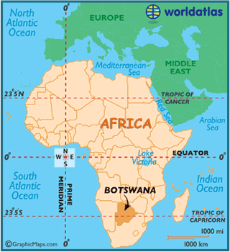
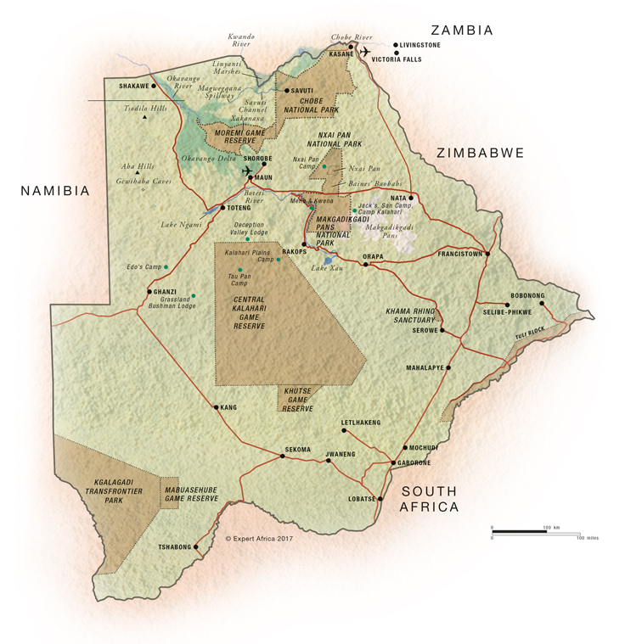

Slide 16
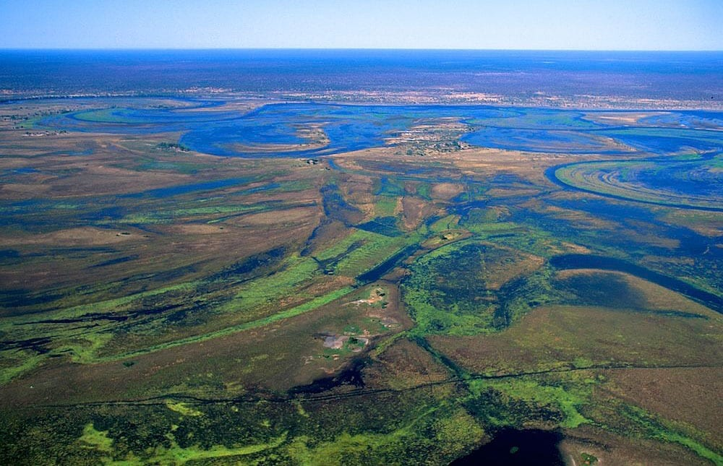

Slide 17
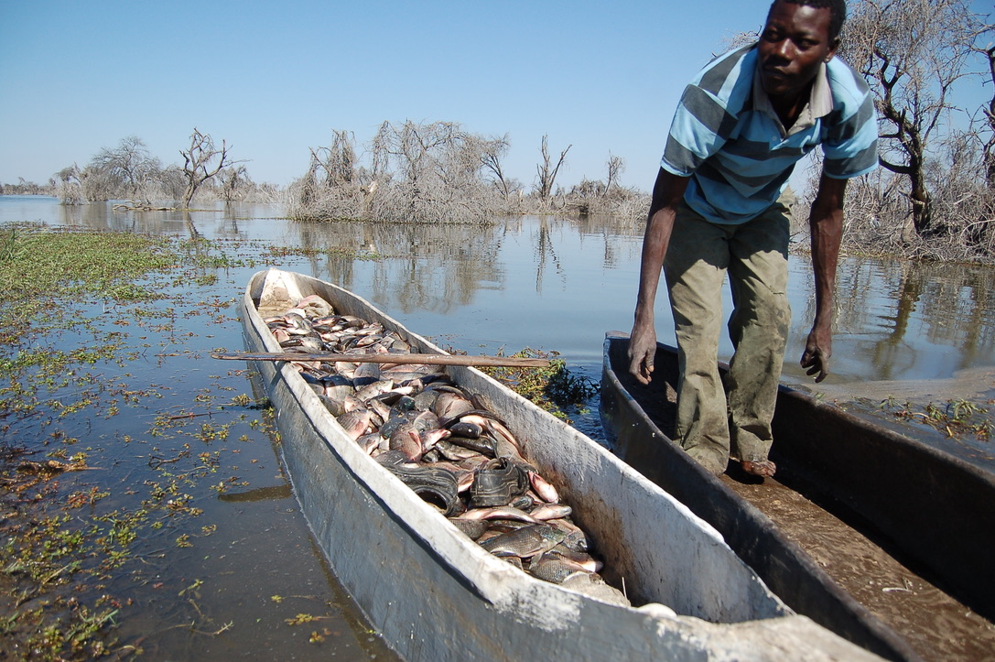

Slide 18
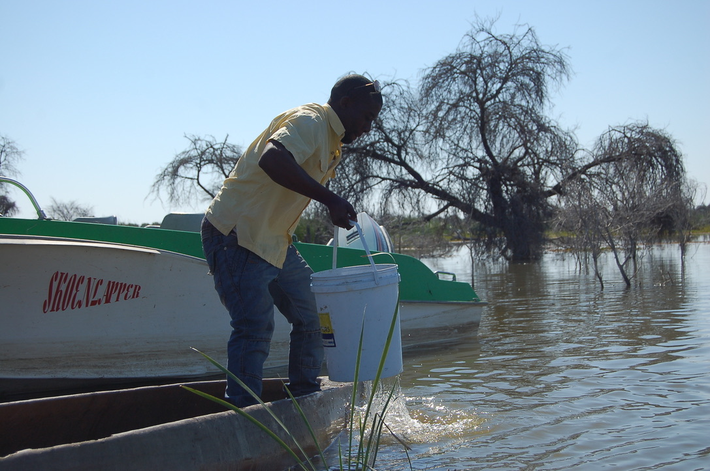

Slide 19
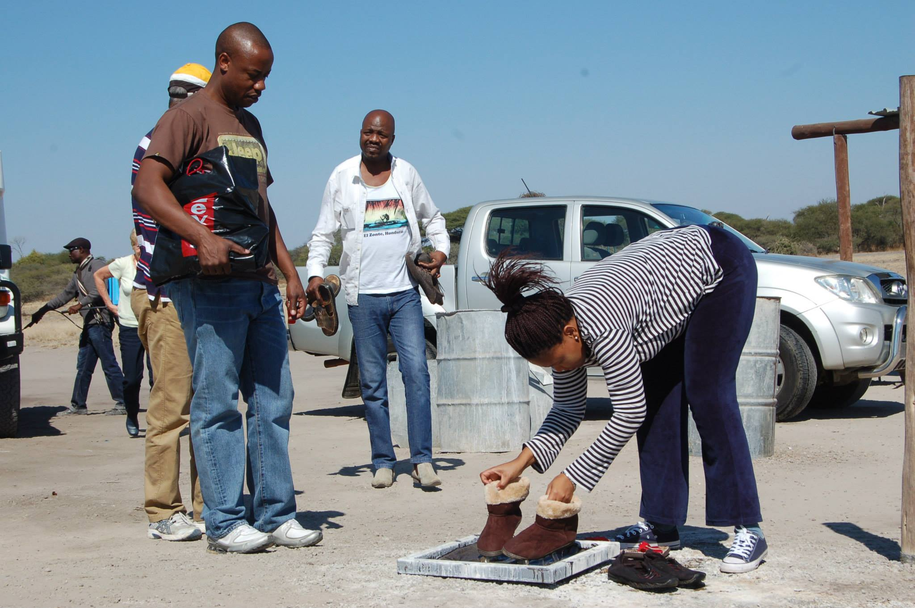

Slide 20
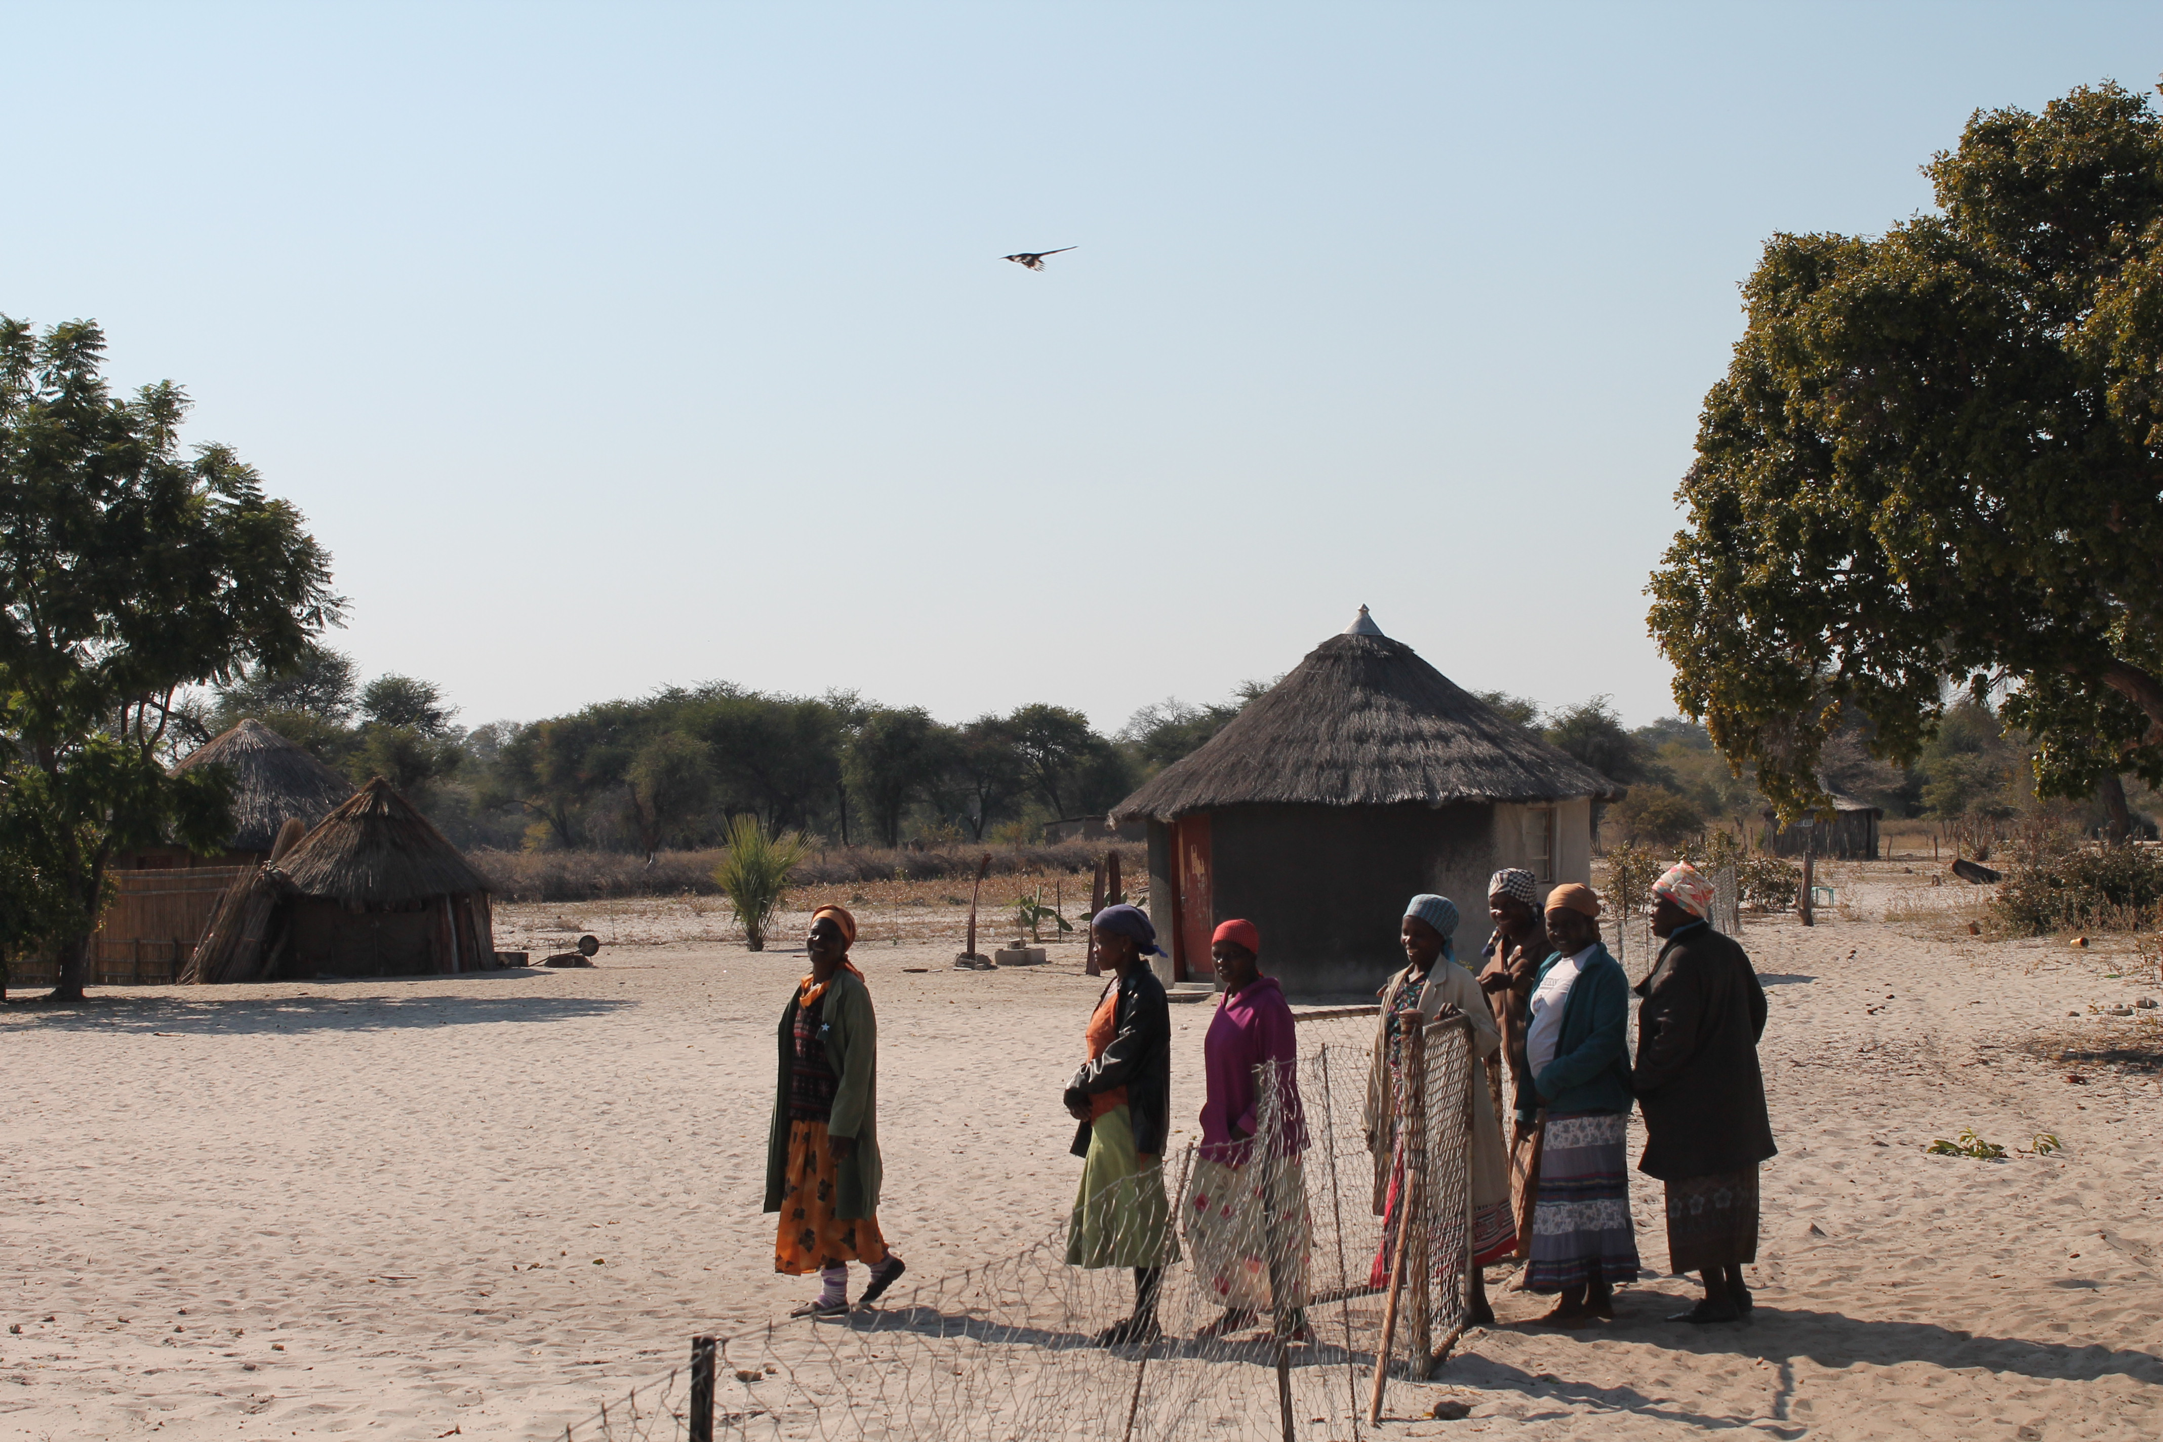

Slide 21
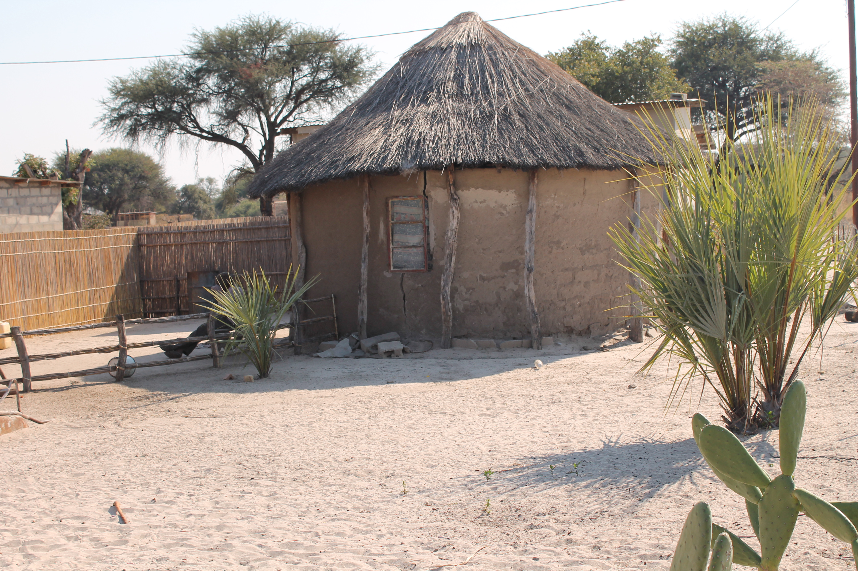

Slide 22
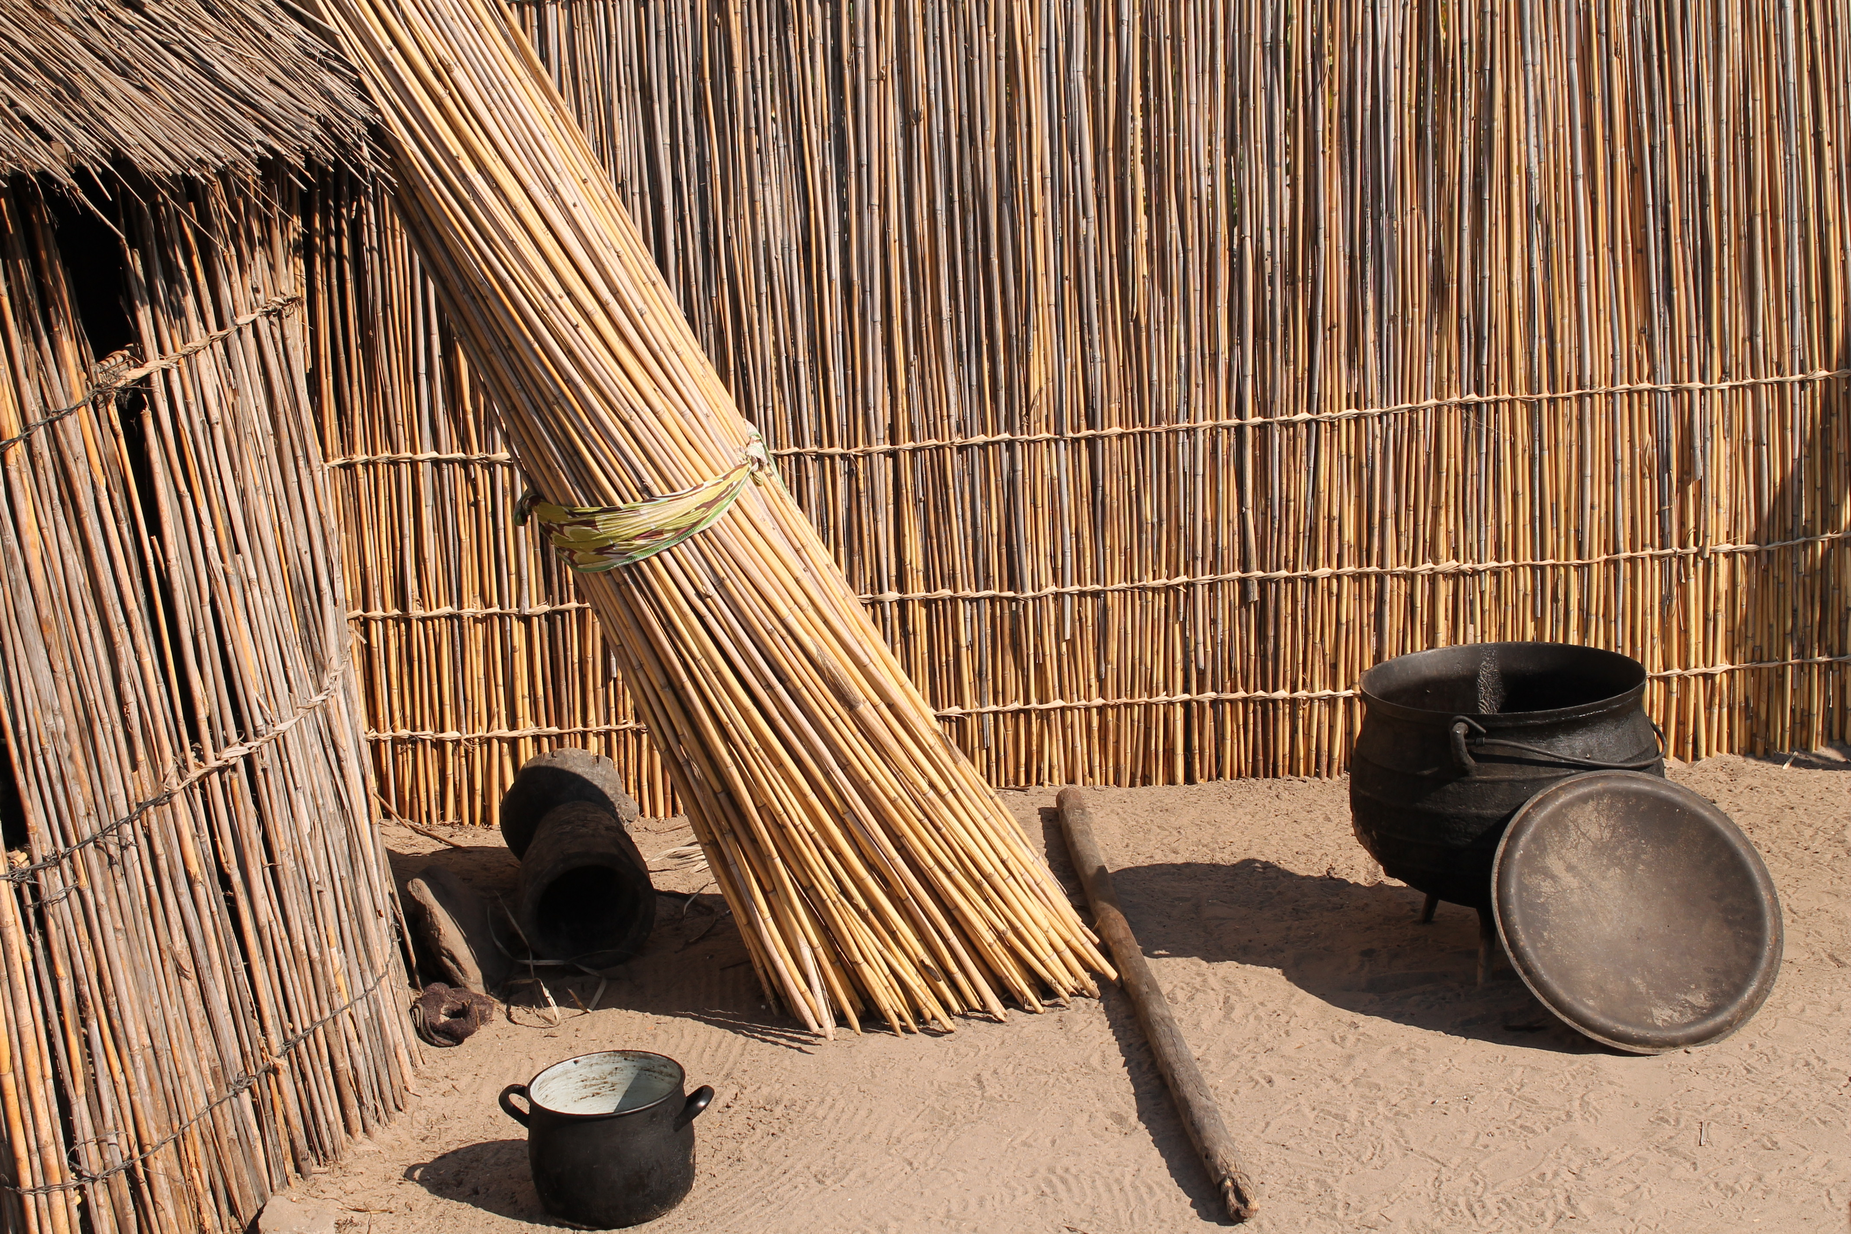

Slide 23
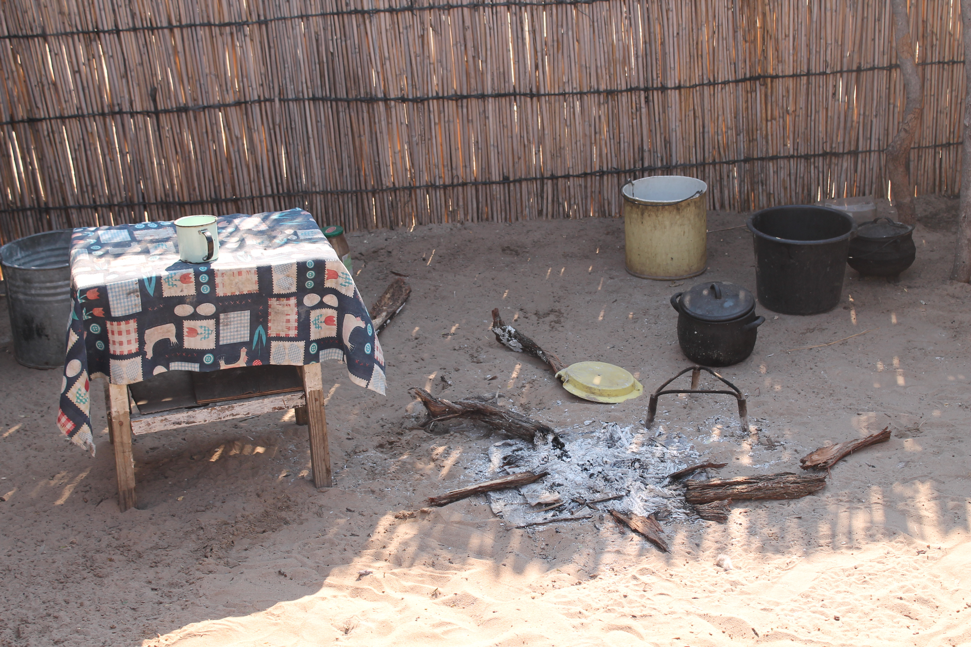

Slide 24
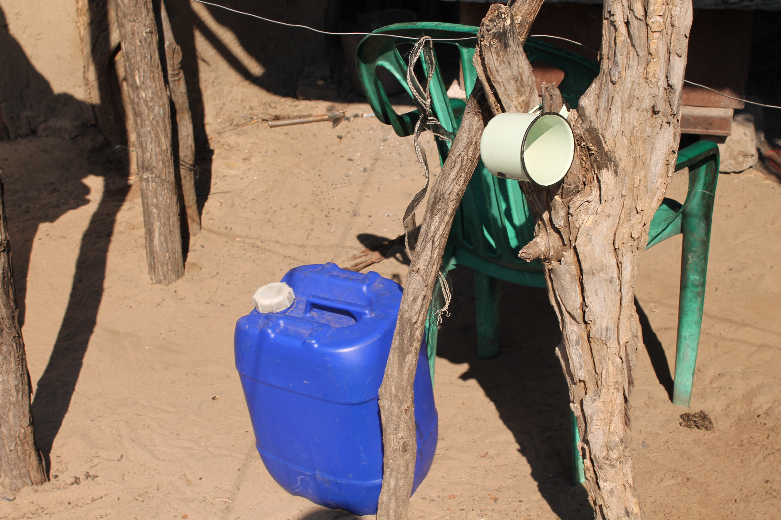

Slide 25
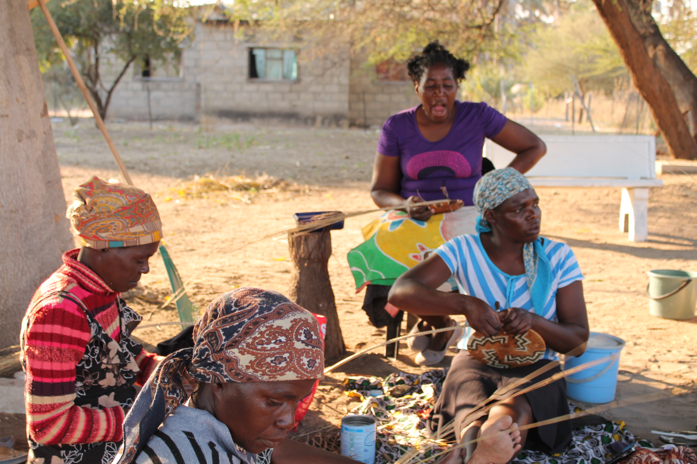

Slide 26
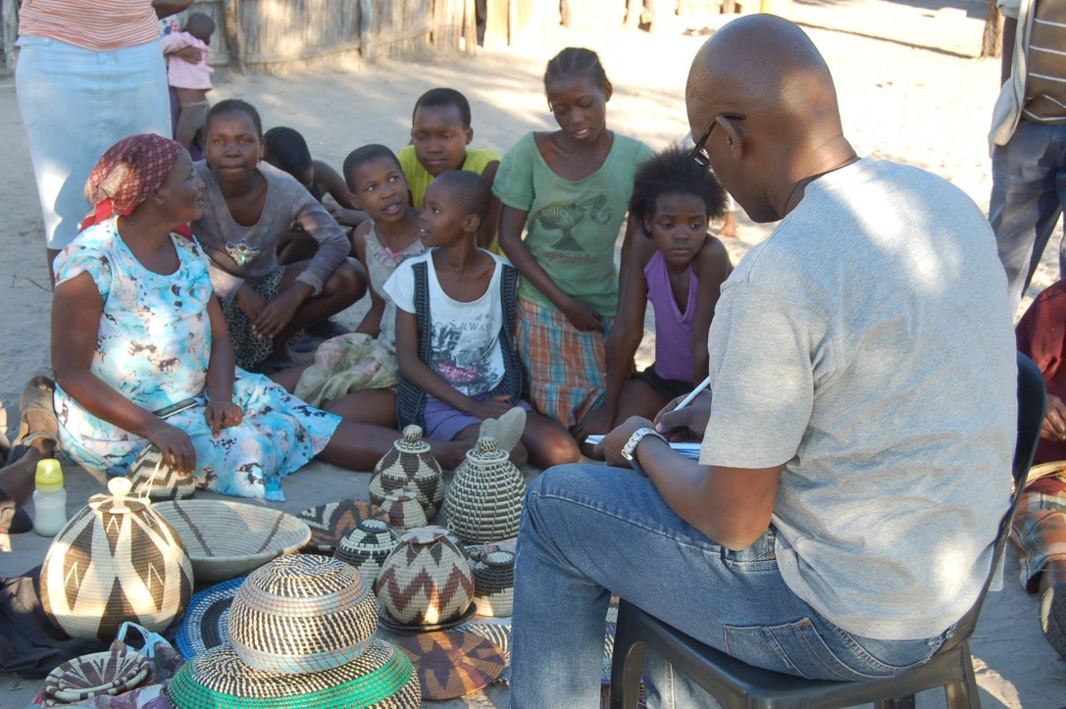

Slide 27
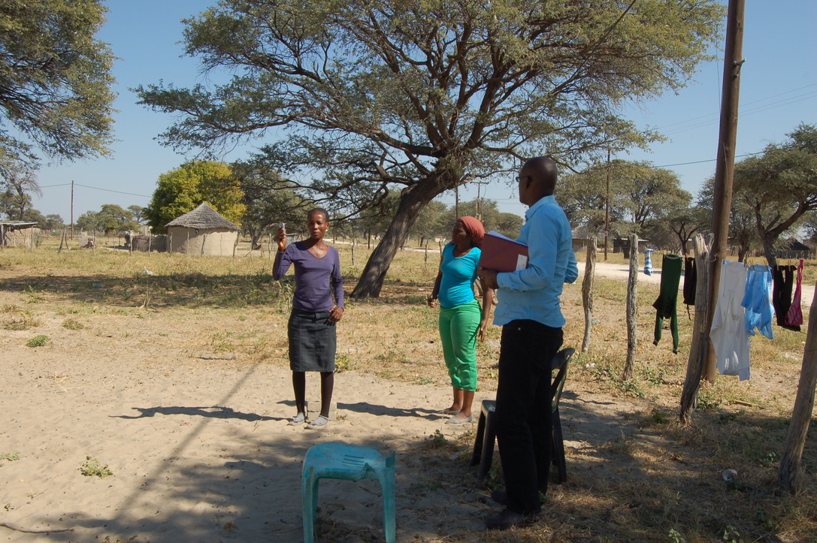

Slide 28
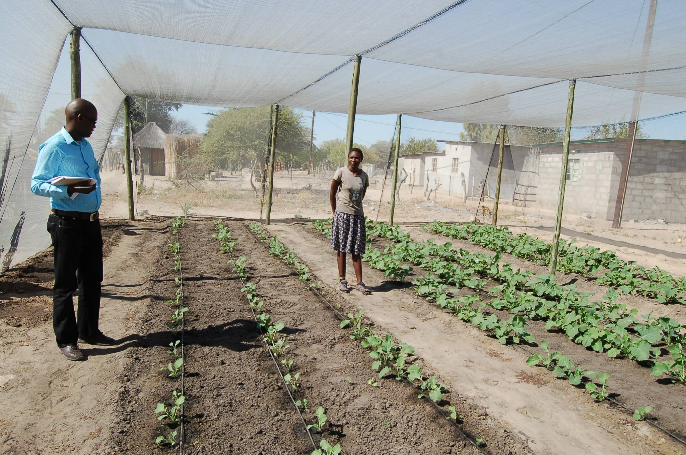

Slide 29
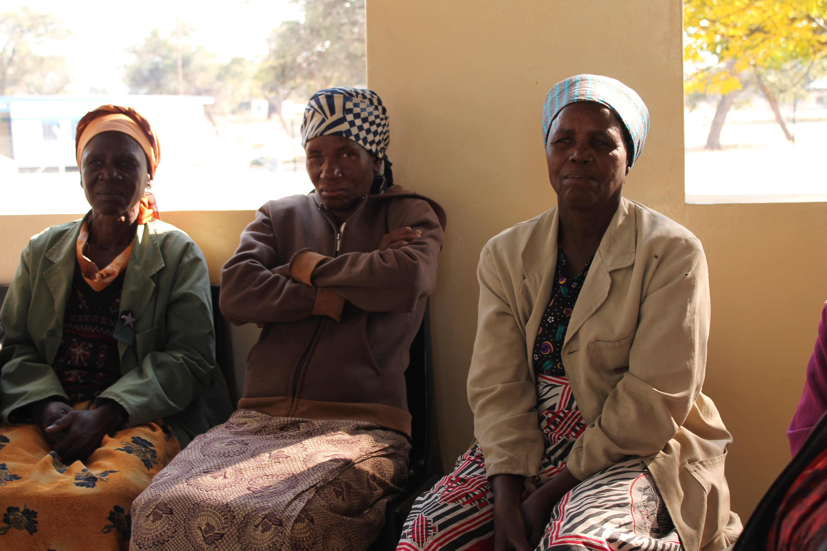

Slide 30
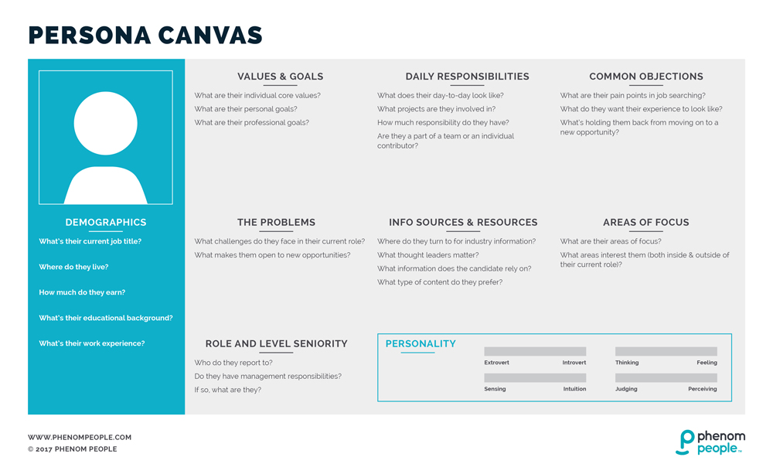

Slide 31
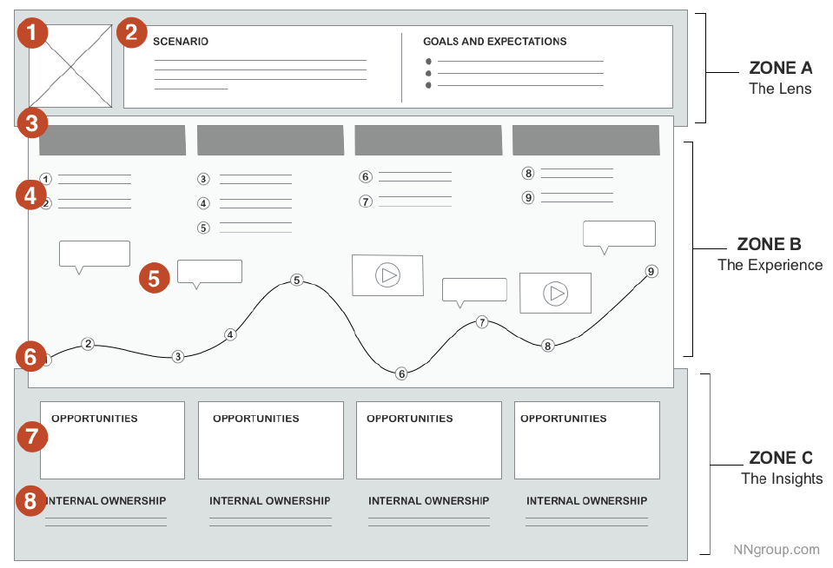
(1) a persona (“who”)
(2) the scenario to be examined (“what”).
(3) chunkable phases of the journey.
(4) Actions
(5) thoughts
(6) emotional experience of the user has throughout the journey can be supplemented with quotes or videos from research.
(7) opportunities to focus on going forward
(8) internal ownership.

Slide 33
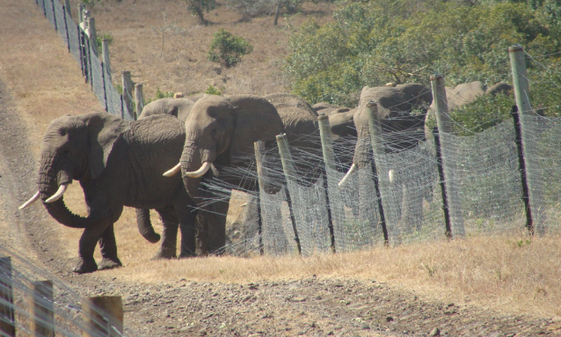

Slide 34
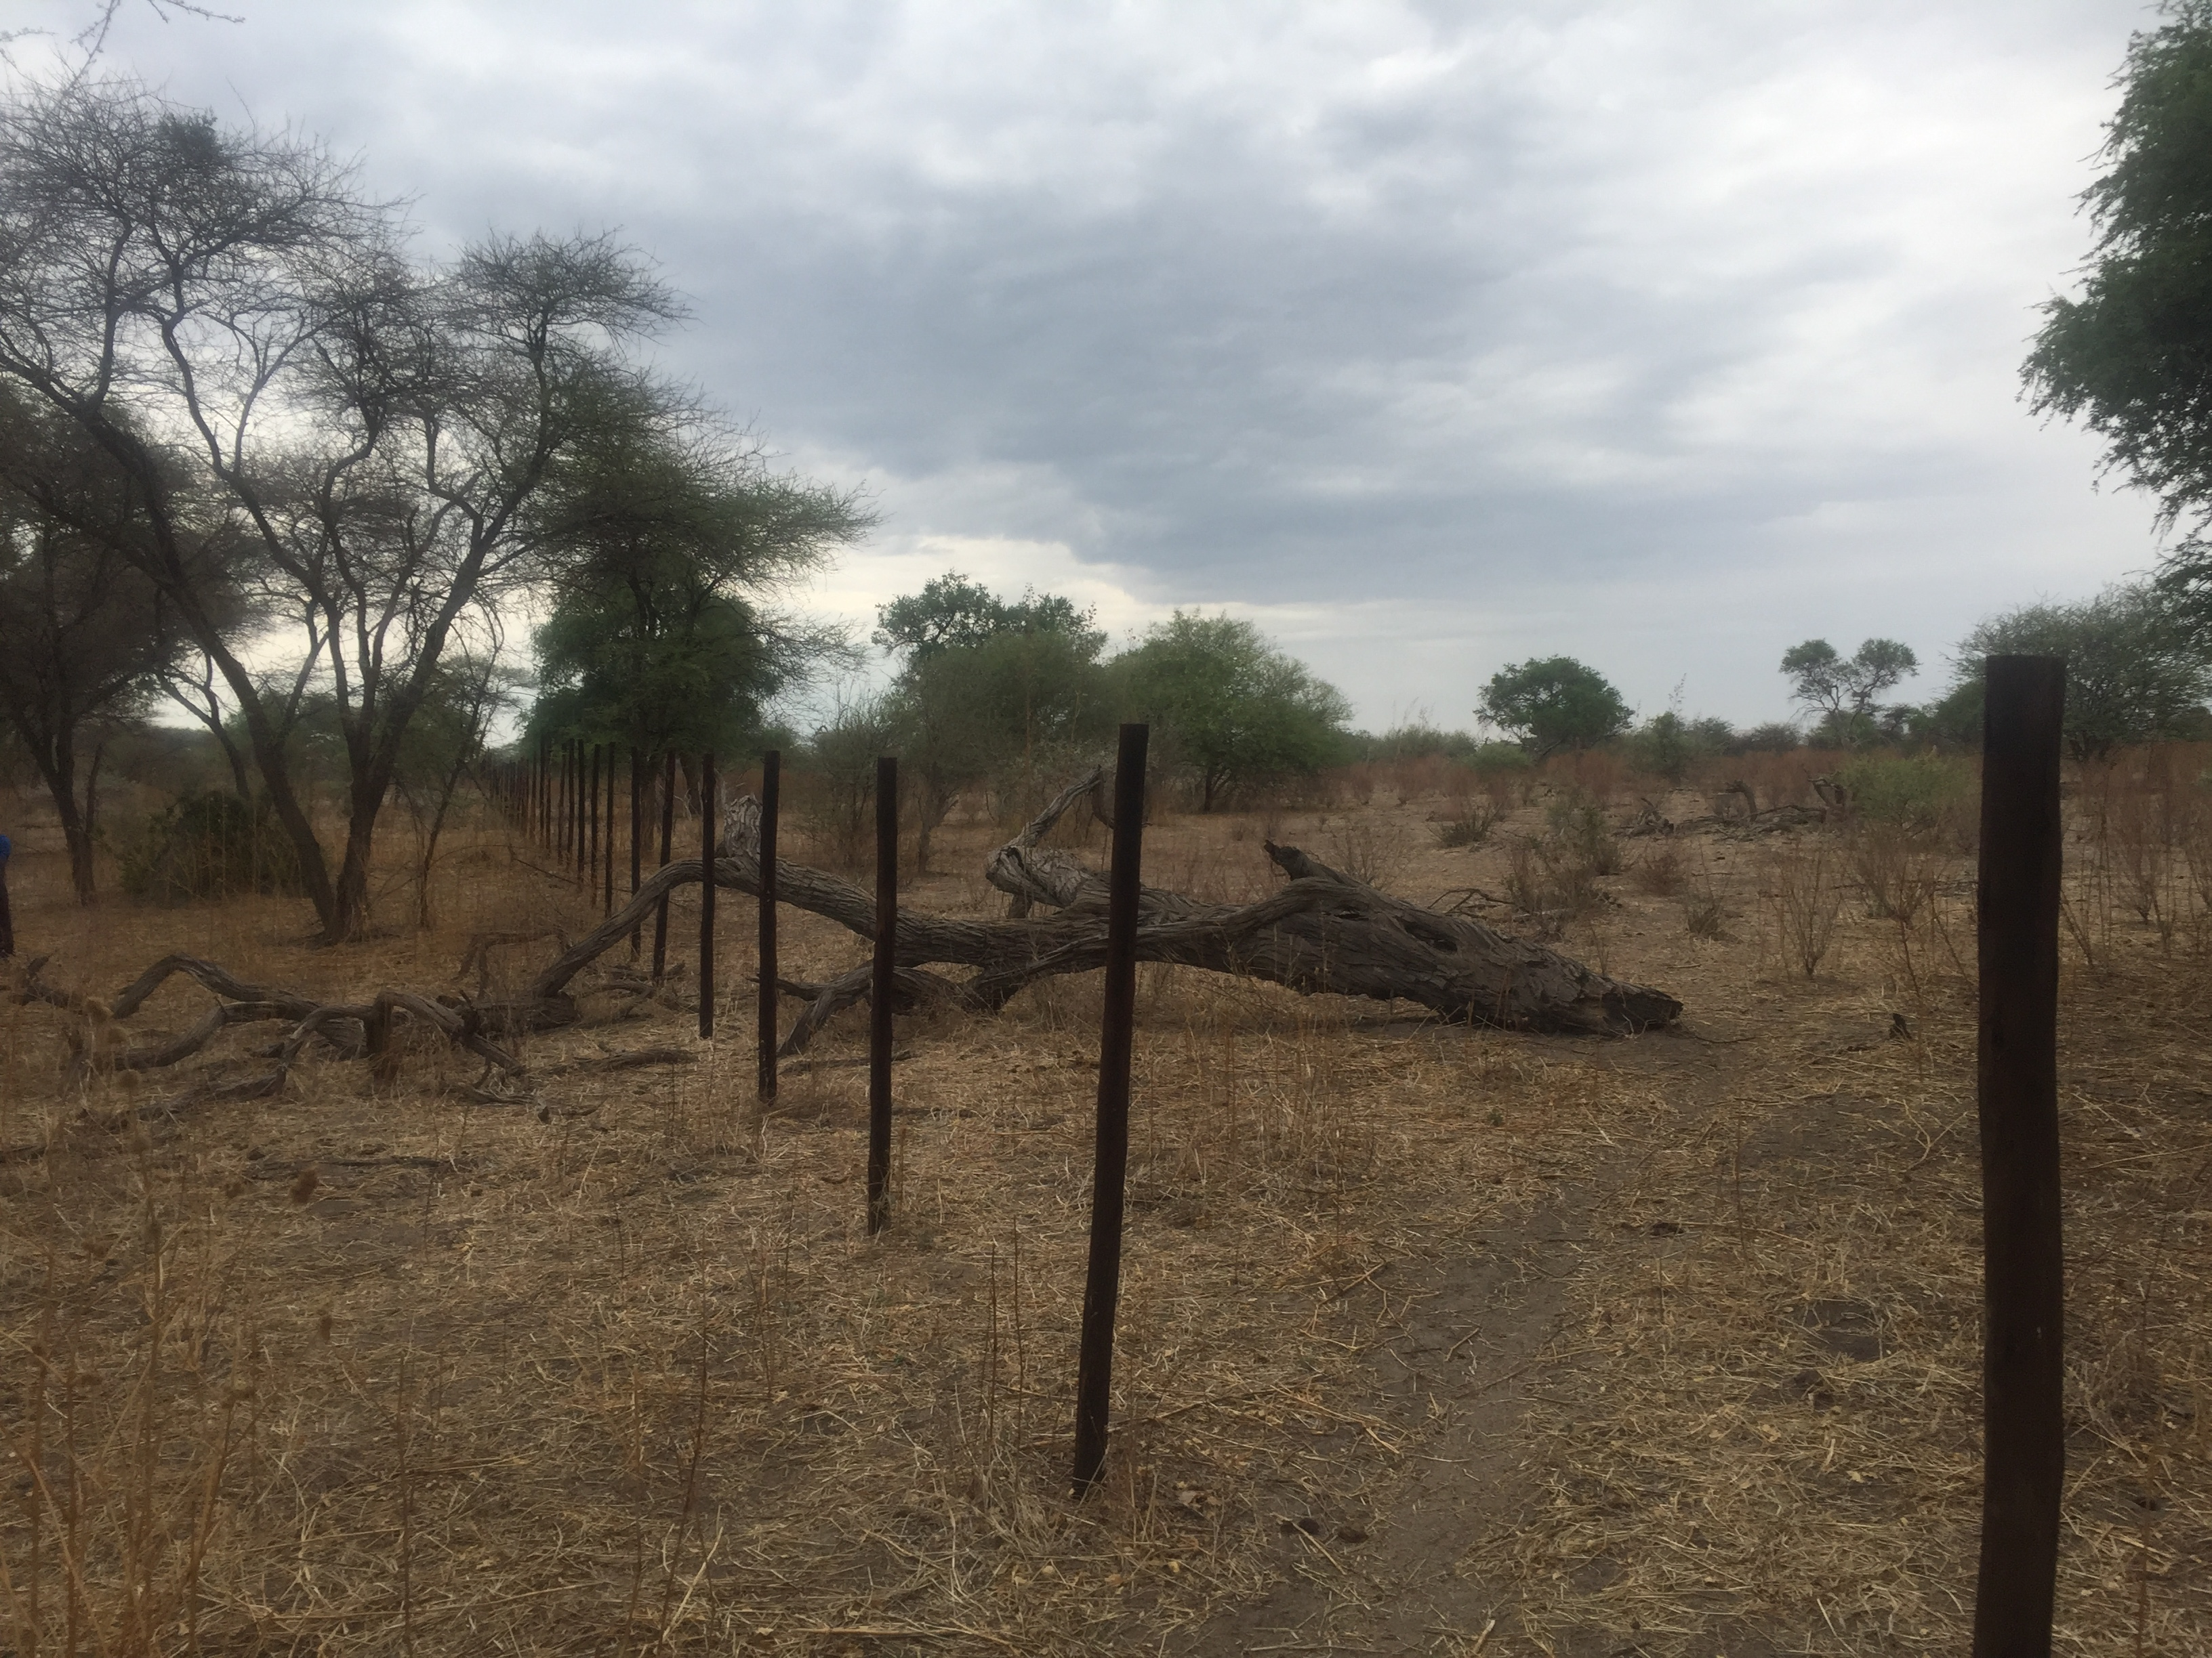

Slide 35
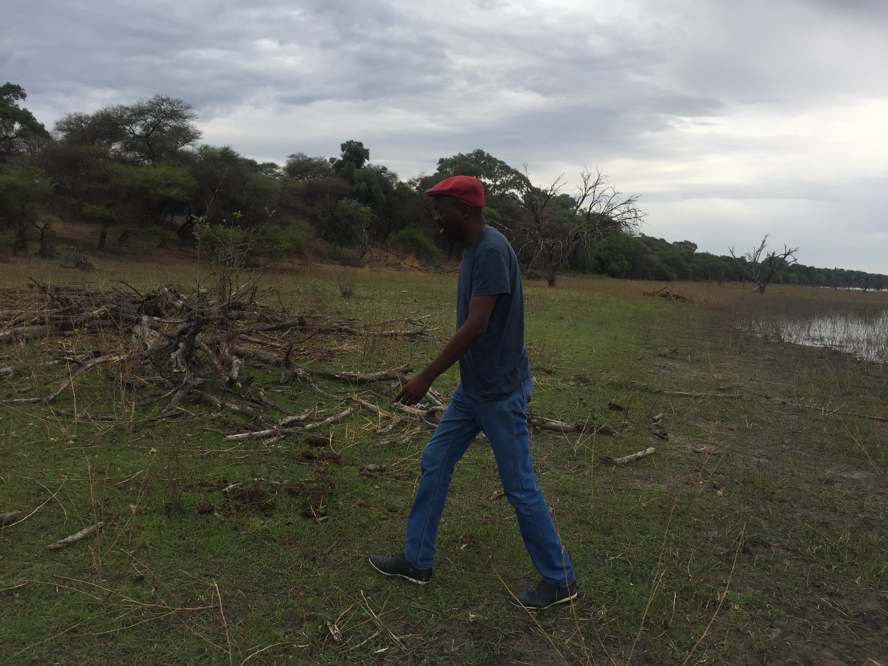

Slide 36


Slide 37
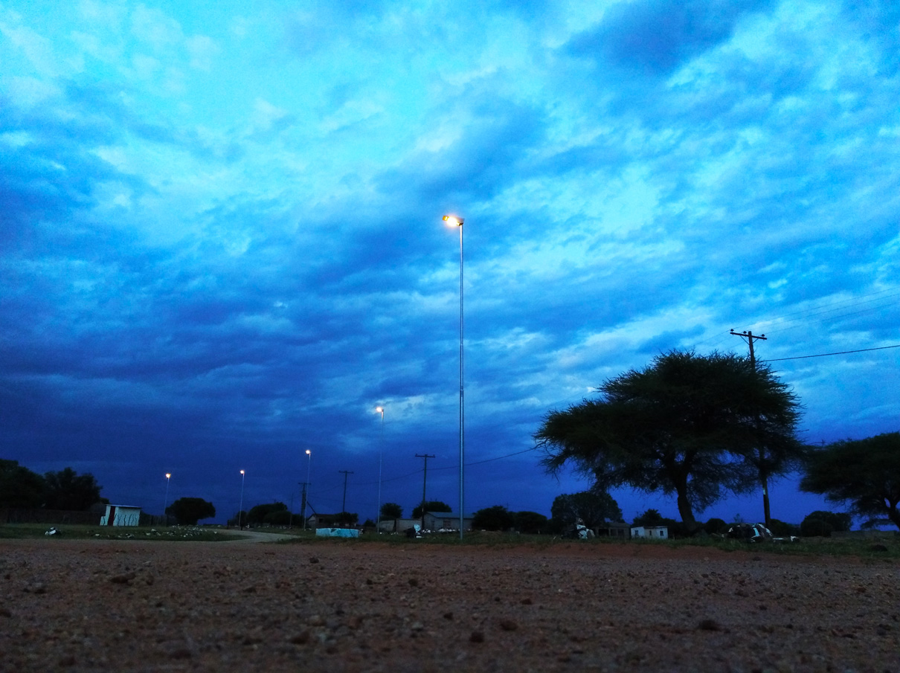

Slide 38
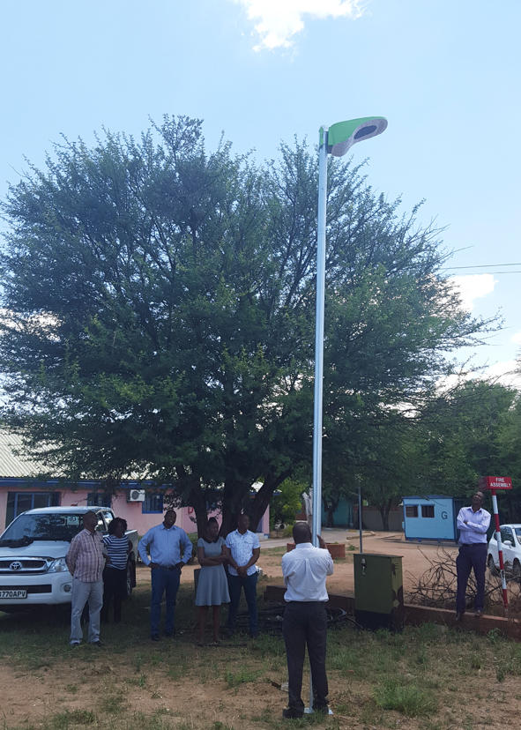

Slide 39
